Slide 1
1 & ONLY
CATALOGUE
1 PIECE MINIMUM GIFTING GUIDE

Slide 2
Table of Contents
06
12
14
19
22
25
26
28
34
38
The cover says it all. Throughout this book you’ll find products offered at one piece minimums. Why is that significant? That’s one gift, designed for one person, with a message specific to the unique bond that links you together.
Speakers & Headphones
Travel Accessories
Smart Technology
Stationery
That’s the magic of bespoke gifting.
This one piece minimum publication is designed to be your guide in this process; to help you effortlessly craft your singularly focused gift, with a singular message, on a budget that reflects that singular mission. It’s a truly personal way to say thank you.
Portable Chargers
Custom Packaging
Backpacks & Duffel Bag
Speakers
Multi-Tools
Nomatic Bags

Slide 3
4
5

Slide 4
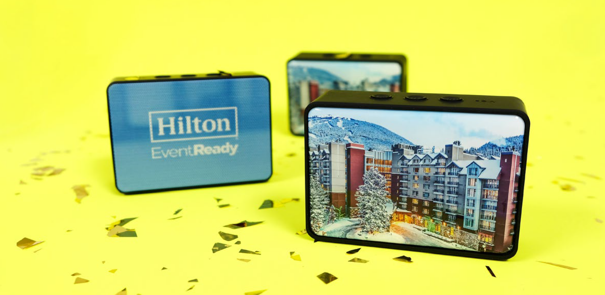
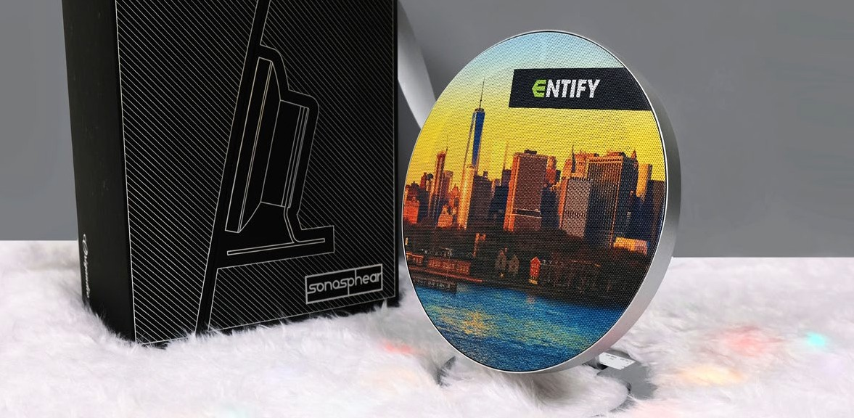
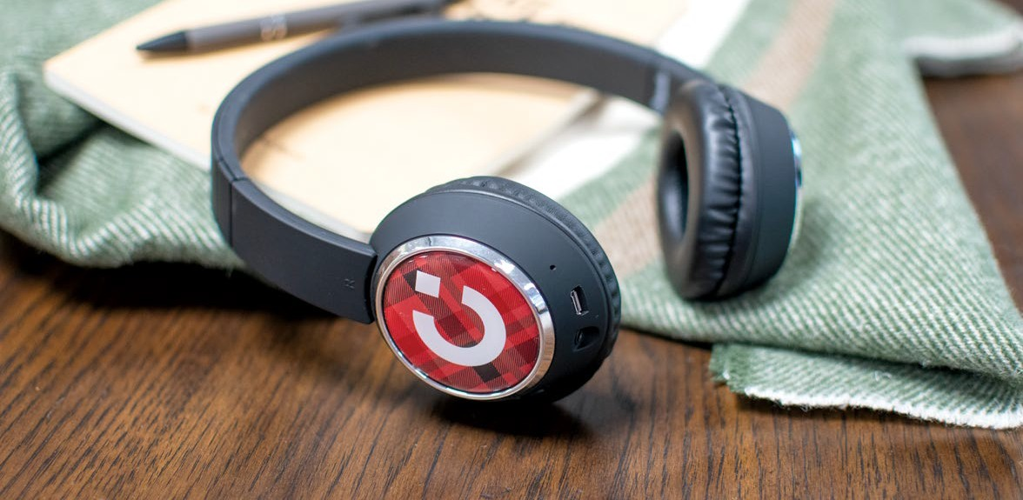
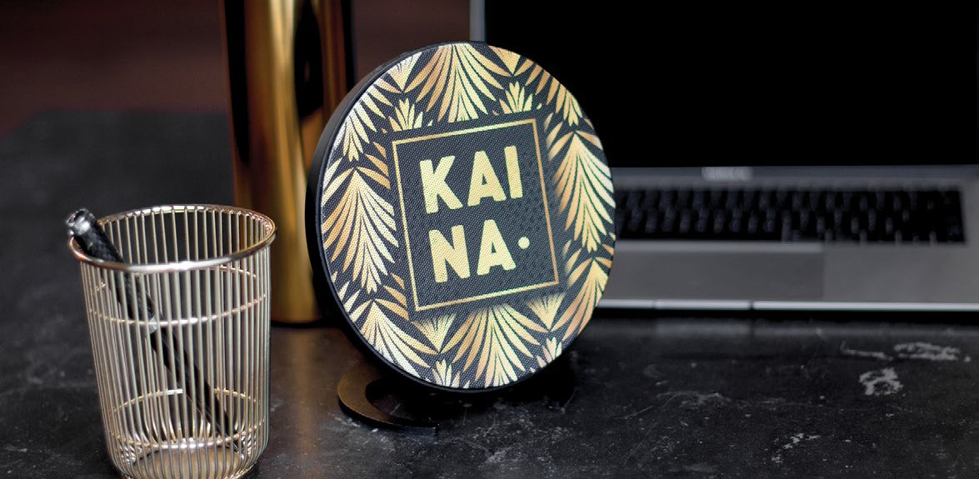
Sonosphear™
Boxanne™
W ir eless S peak er
+
OR2301
OR2319
W ir eless S peak er
+
QTY | 1 | 10 | 25 | 50 | 100 |  | QTY 1 | 10 | 25 | 50 | 100
5C | 47.66 | 43.50 | 40.52 | 39.33 | 36.95 |  | 5C 202.96 | 195.34 | 182.64 | 180.13 | 167.43
Beebop™
W ir eless H eadphones
+
OR2802
Mini Sonos™
W ir eless S peak er
+
OR2318
QTY | 1 | 10 | 25 | 50 | 100 |  | QTY 1 | 10 | 25 | 50 | 100
5C | 57.85 | 55.21 | 52.58 | 49.96 | 47.31 |  | 5C 182.48 | 159.01 | 148.58 | 135.56 | 125.13
6
7

Slide 5
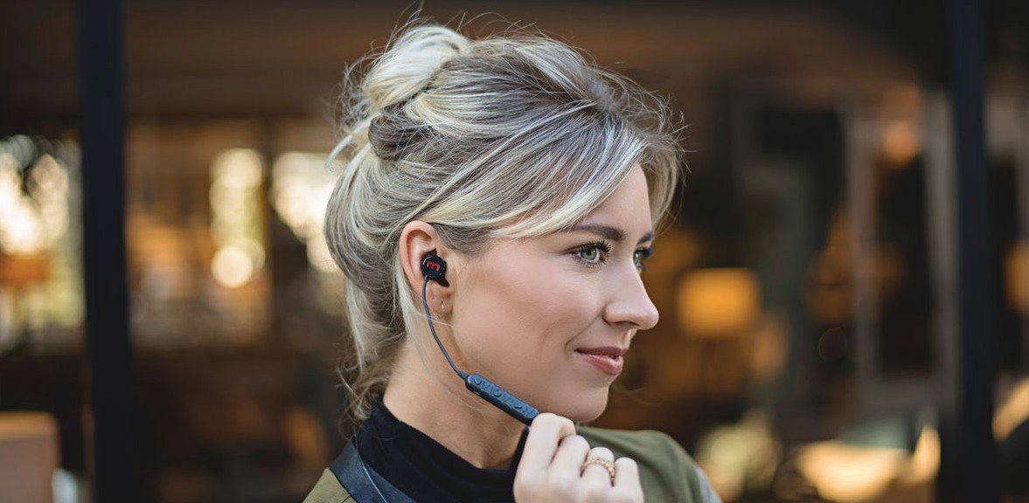
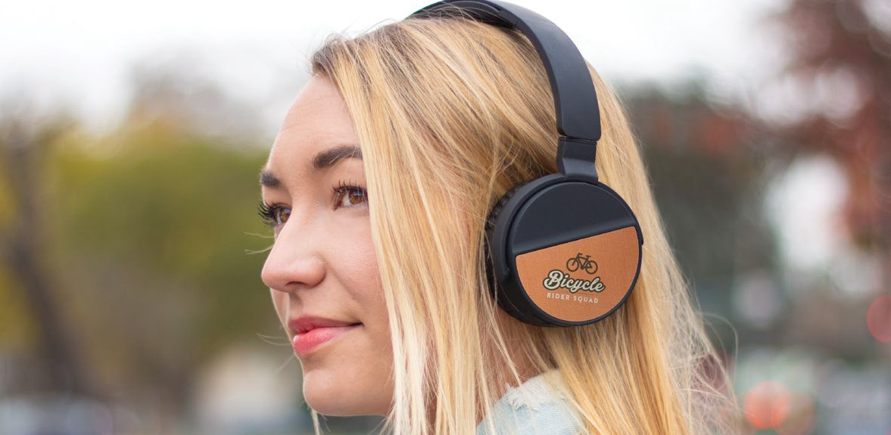
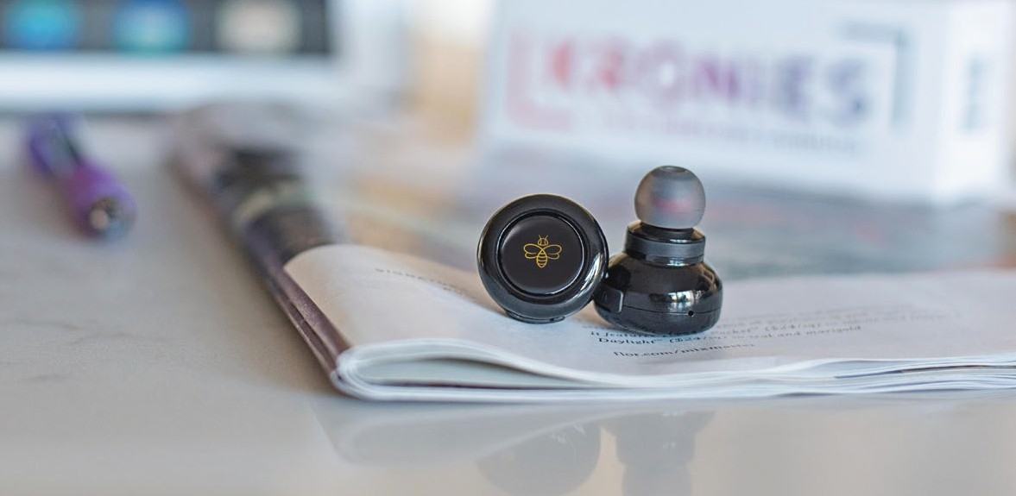
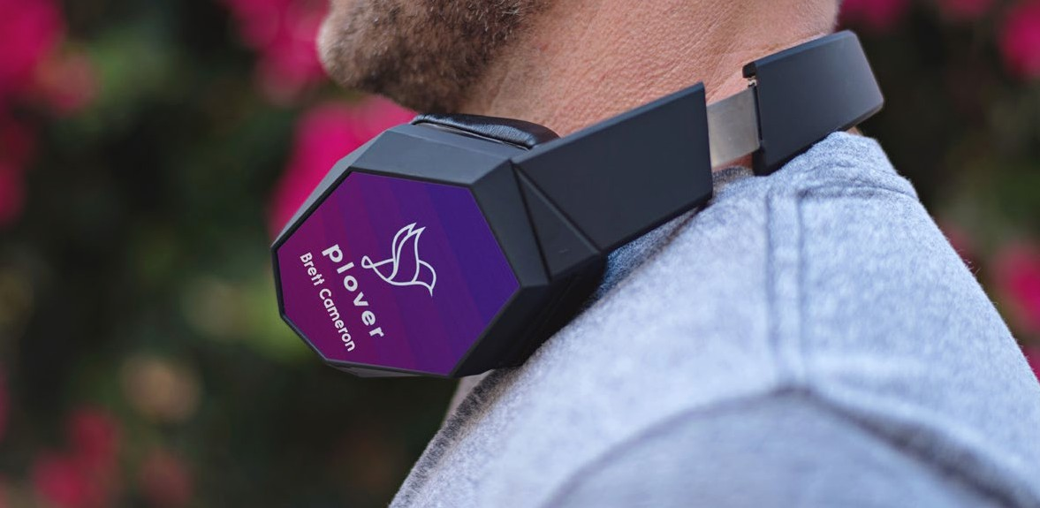
Lunatune™
Budsies™
W ir eless E arbuds
+
OR2502
OR2812
W ir eless H eadphones
+
QTY | 1 | 10 | 25 | 50 | 100 |  | QTY 1 | 10 | 25 | 50 | 100
5C | 39.02 | 35.35 | 31.07 | 28.65 | 25.00 |  | 5C 101.95 | 96.06 | 88.88 | 86.25 | 81.05
Kronies™
True W ir eless E arbuds
+
OR2511
Wrapsody™
W ir eless H eadphones
+
OR2823
QTY | 1 | 10 | 25 | 50 | 100 |  | QTY 1 | 10 | 25 | 50 | 100
5C | 62.56 | 58.81 | 55.05 | 52.56 | 47.55 |  | 5C 152.88 | 145.23 | 142.69 | 140.13 | 137.59
8
9

Slide 6
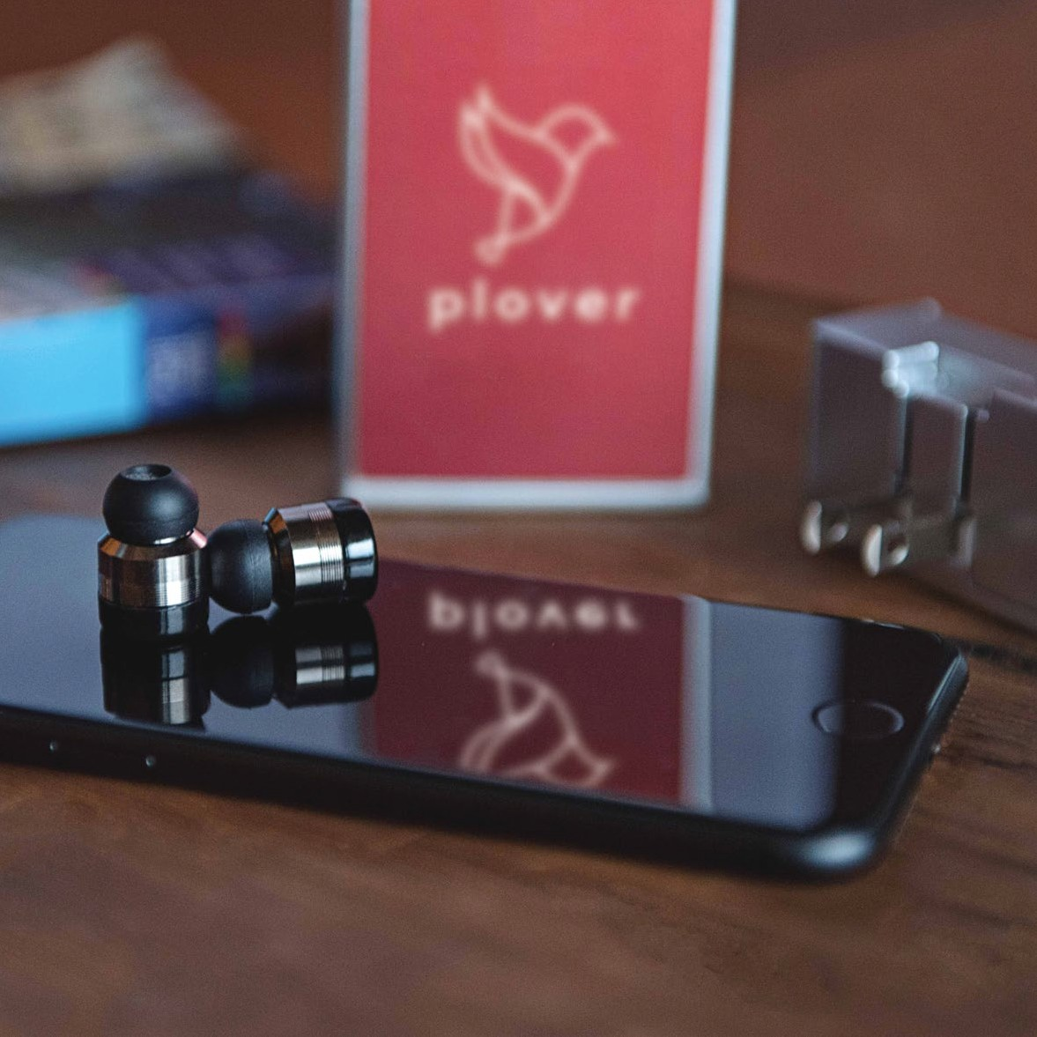
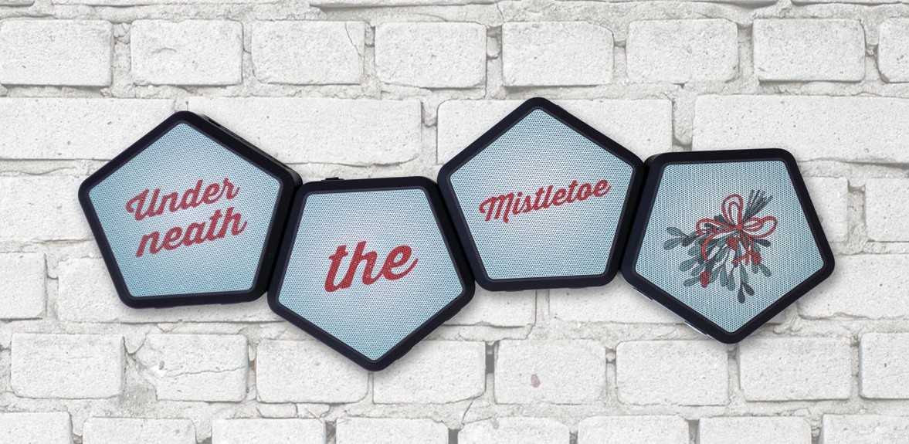
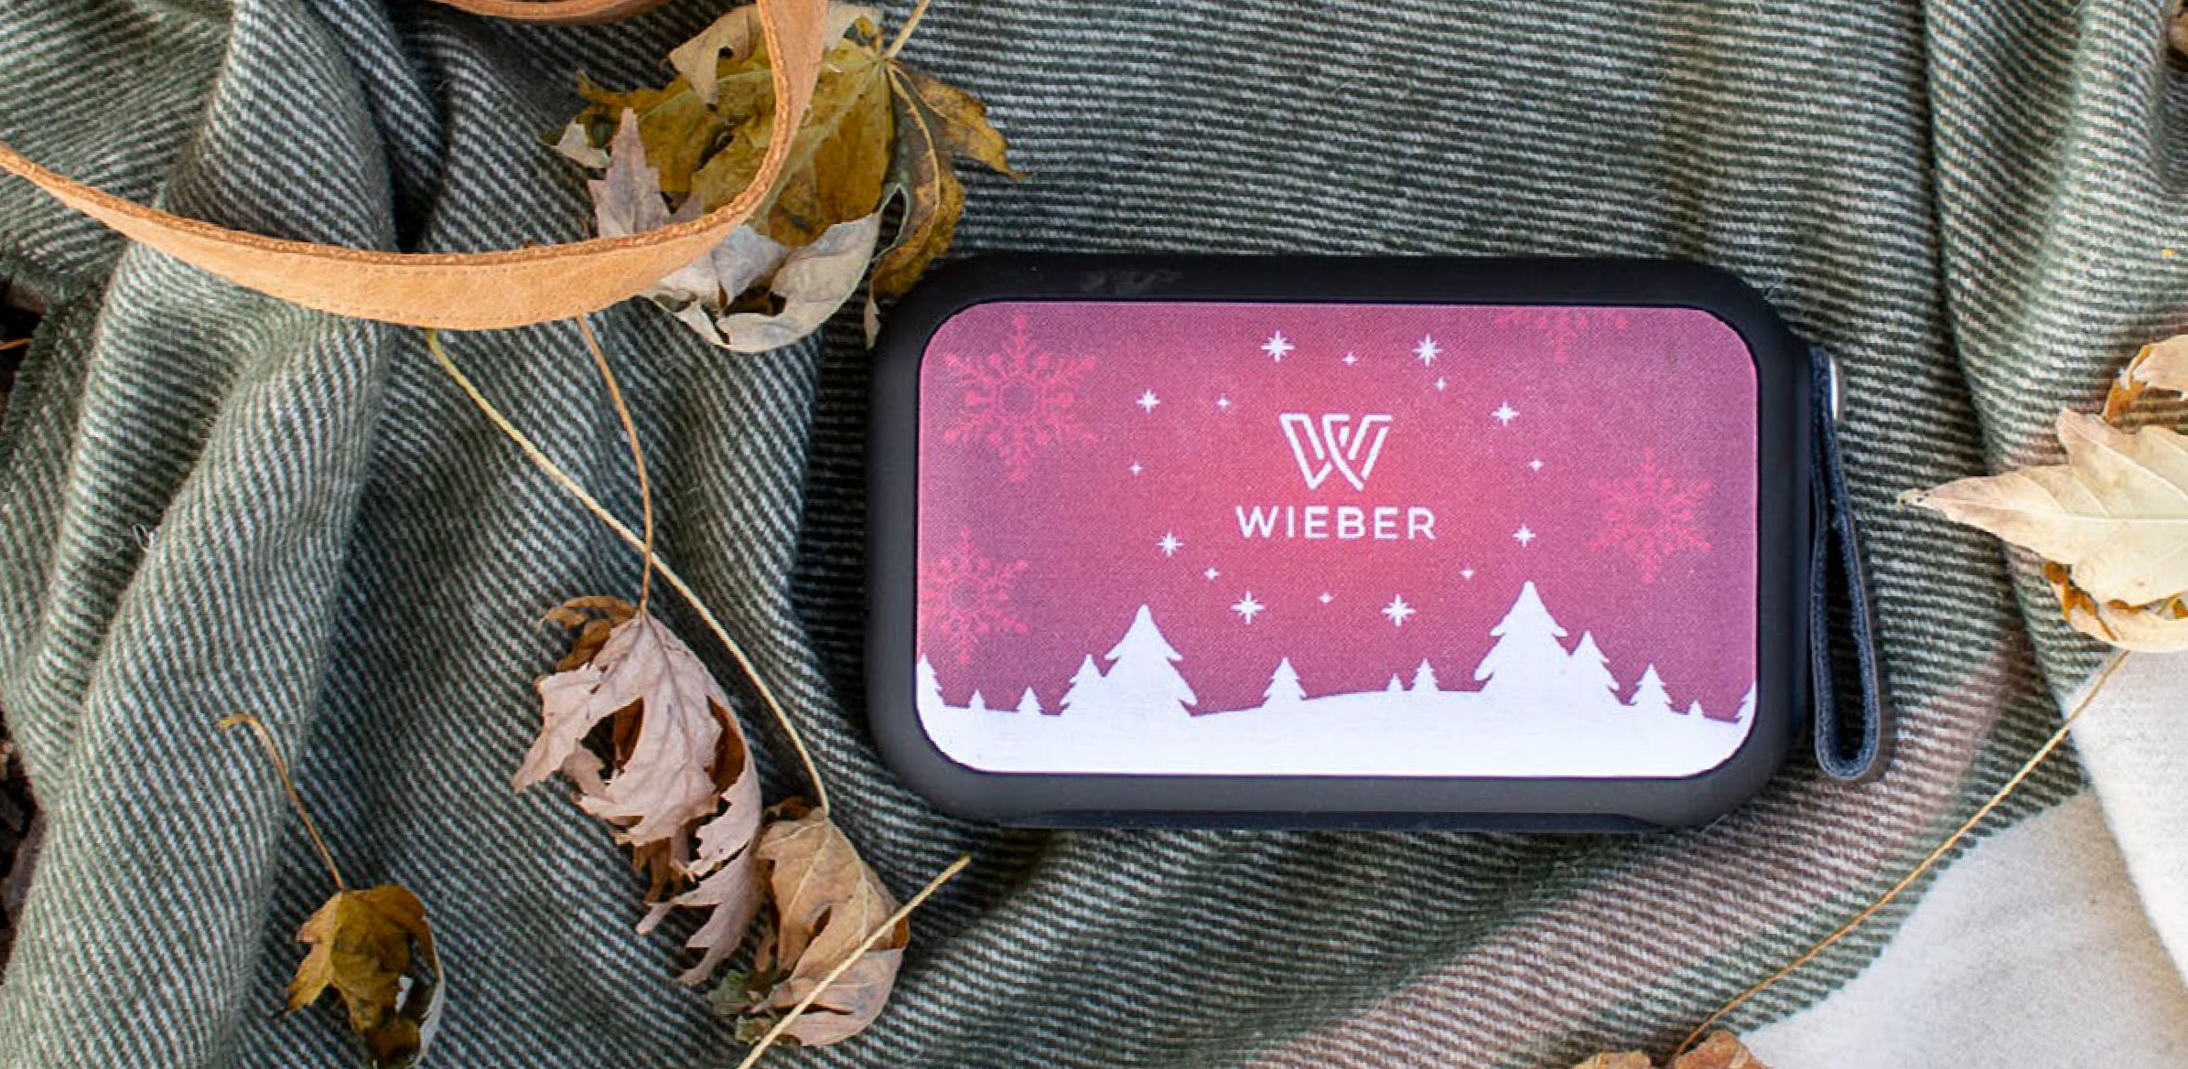
Pionears™
OR2516
Hive™
True W ir eless S urr ound Sound S peak er
+
OR2308
True W ir eless E arbuds + Power B ank
+
QTY | 1 | 10 | 25 | 50 | 100
5C | 95.35 | 88.20 | 83.41 | 81.05 | 76.26
Thumpah™
W ir eless S peak er
+
OR2320
QTY | 1 | 10 | 25 | 50 | 100 |  | QTY 1 | 10 | 25 | 50 | 100
5C | 183.44 | 175.81 | 170.71 | 168.16 | 161.81 |  | 5C 134.39 | 124.60 | 117.60 | 114.80 | 109.20
10
11

Slide 7
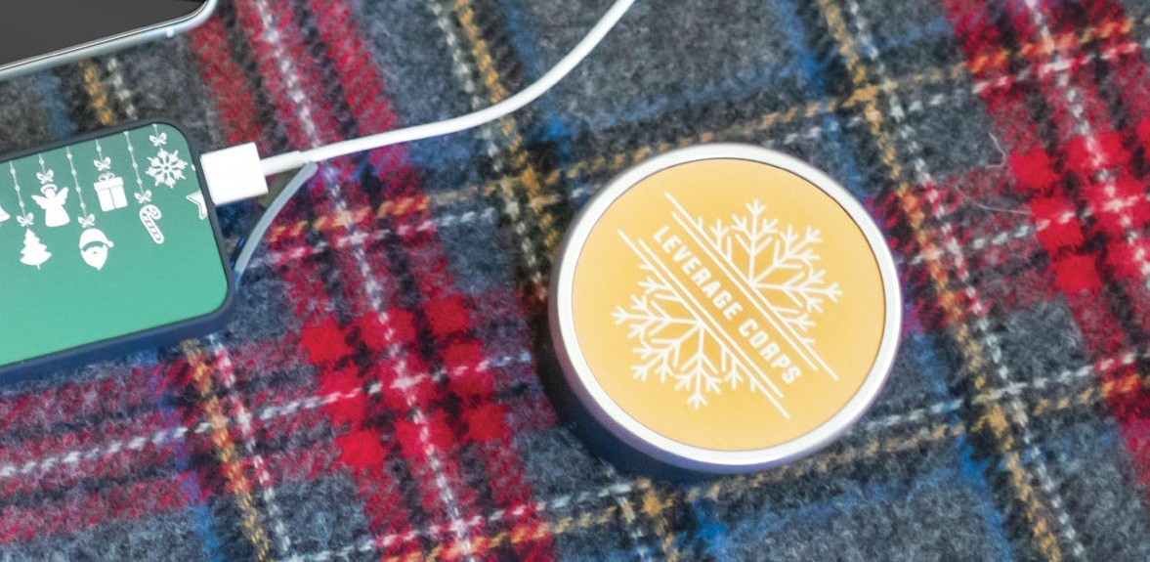
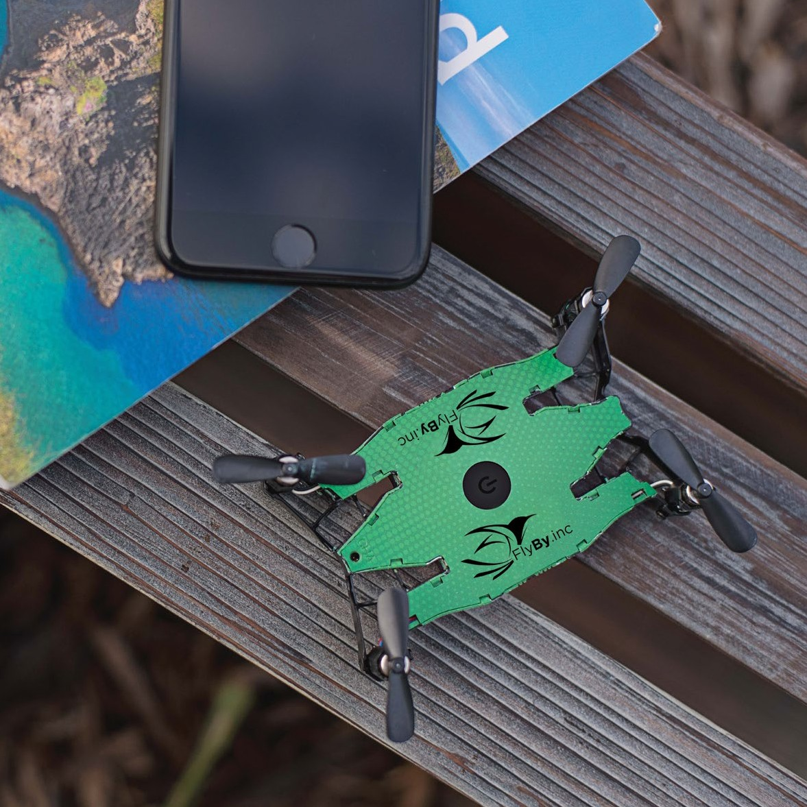
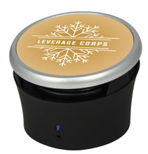
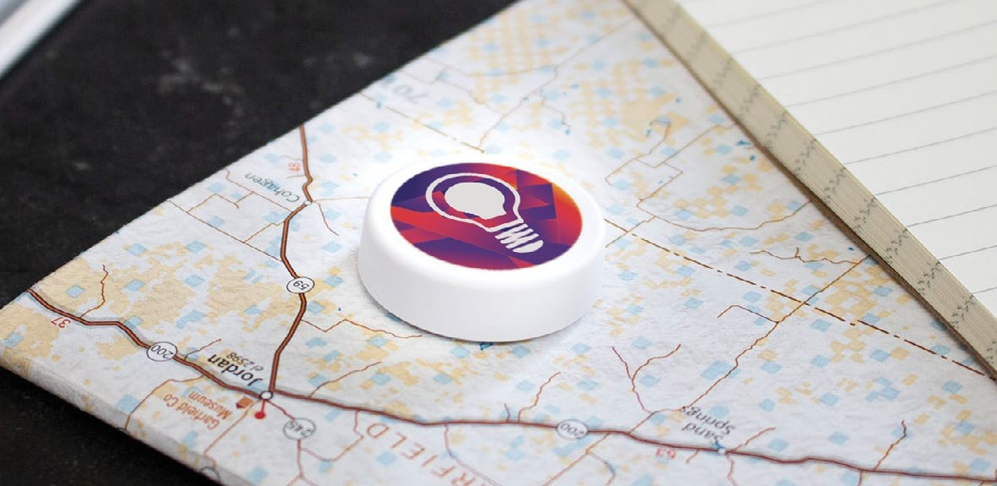
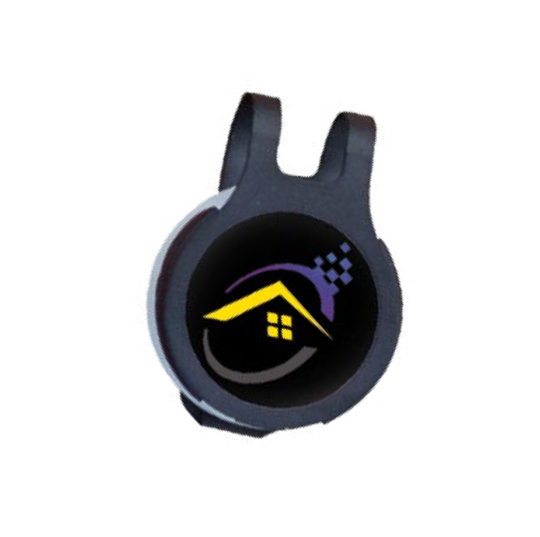
Bumpster™
OR2302
Flyington™
Self ie D r one
+
OR2206
W ir eless S peak er
+
QTY | 1 | 10 | 25 | 50 | 100
5C | 67.56 | 62.56 | 60.06 | 58.81 | 55.05
Onyt™
App- E nabled S mart B utton
+
OR2200
QTY | 1 | 10 | 25 | 50 | 100 |  | QTY 1 | 10 | 25 | 50 | 100
5C | 58.98 | 54.61 | 50.23 | 48.05 | 44.76 |  | 5C 155.16 | 147.66 | 140.14 | 137.64 | 130.13
12
13

Slide 8
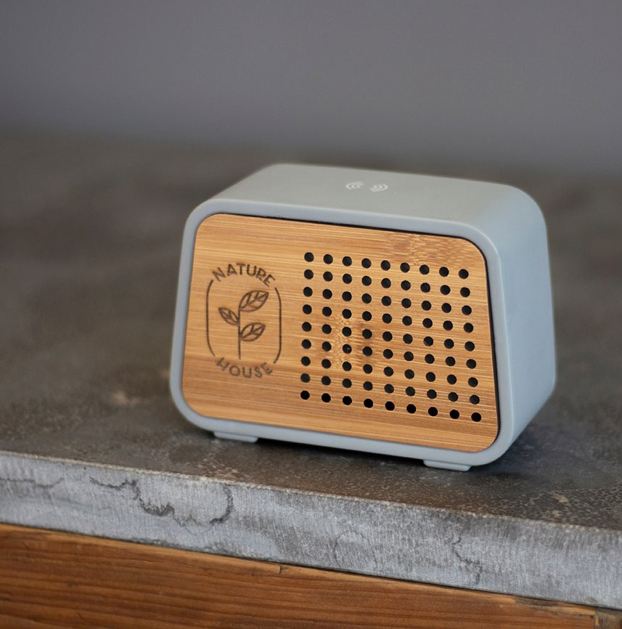
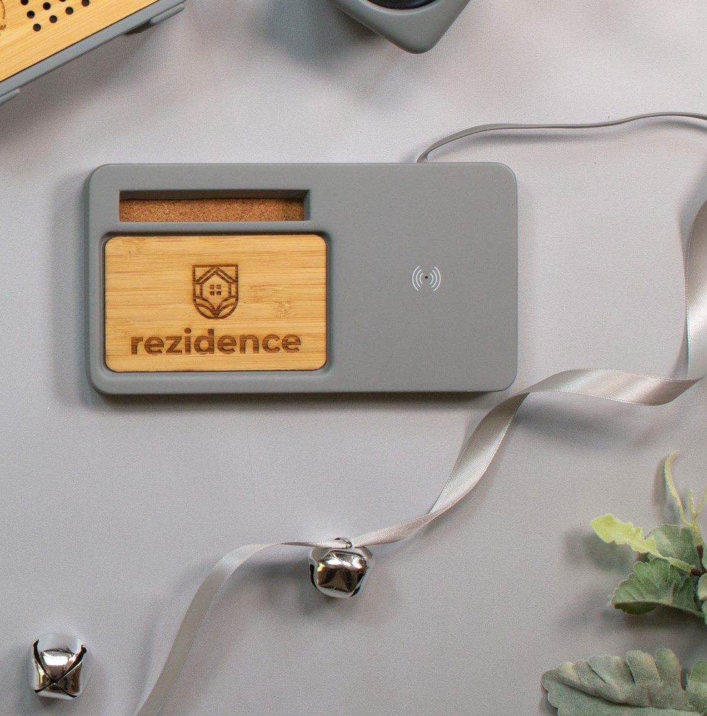
Temblor™
OR2310
Power Mantle™
W ir eless C har ger
+
OR2311
S peak er + W ir eless C har ger
+
QTY | 1 | 10 | 25 | 50 | 100 |  | QTY 1 | 10 | 25 | 50 | 100
5C | 75.08 | 70.06 | 65.06 | 62.56 | 57.56 |  | 5C 62.56 | 57.56 | 56.31 | 50.05 | 45.05
14
15

Slide 9
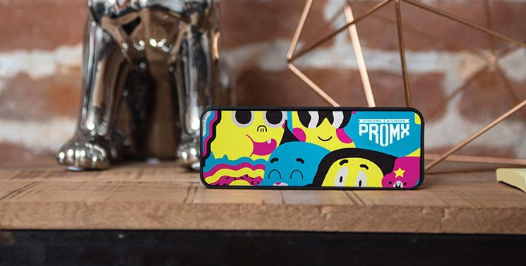
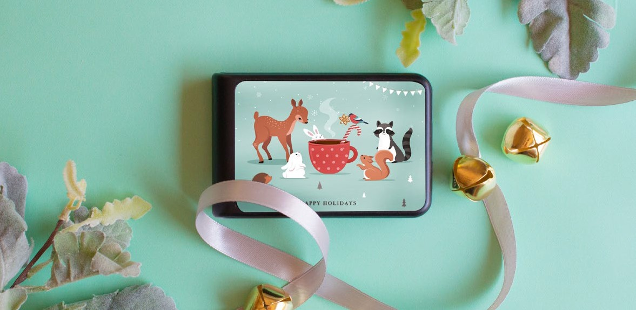
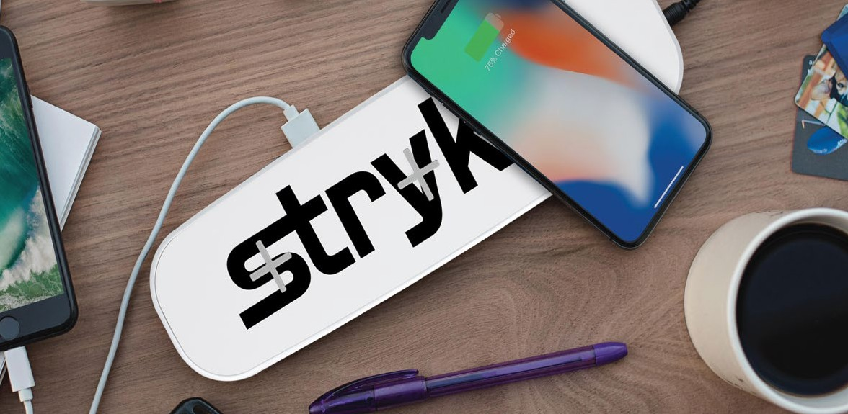
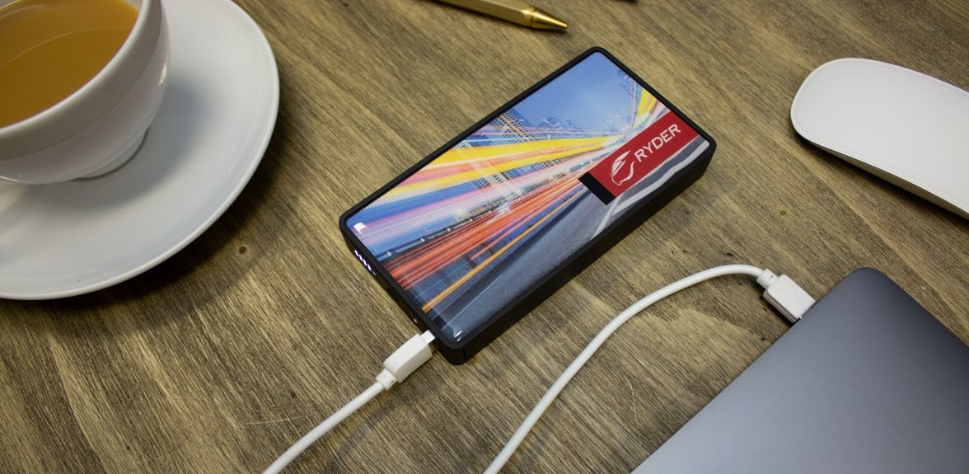
EvryBox™
OR2305
TenFour 2.0™
Power B ank
+
OR2914
C har ger + S peak er
+
QTY | 1 | 10 | 25 | 50 | 100 |  | QTY 1 | 10 | 25 | 50 | 100
5C | 92.60 | 82.58 | 76.33 | 73.83 | 67.56 |  | 5C 83.73 | 75.88 | 68.05 | 65.40 | 60.18
Boltron™
W ir eless C har ging Pad
+
OR2902
Octoforce™
Power B ank
+
OR2915
QTY | 1 | 10 | 25 | 50 | 100 |  | QTY 1 | 10 | 25 | 50 | 100
5C | 124.85 | 117.20 | 109.56 | 107.01 | 101.91 |  | 5C 88.73 | 82.81 | 76.90 | 73.95 | 68.05
16
17

Slide 10
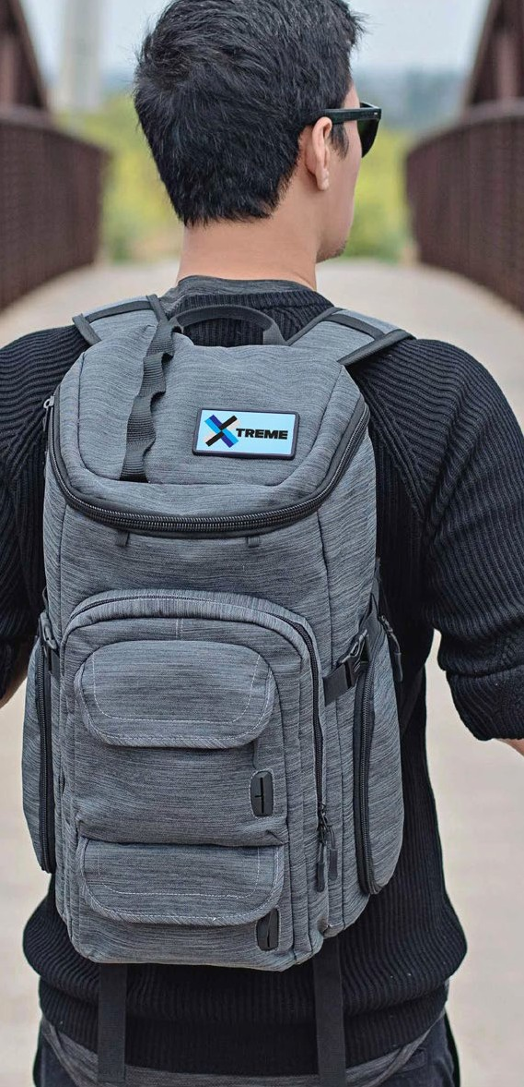
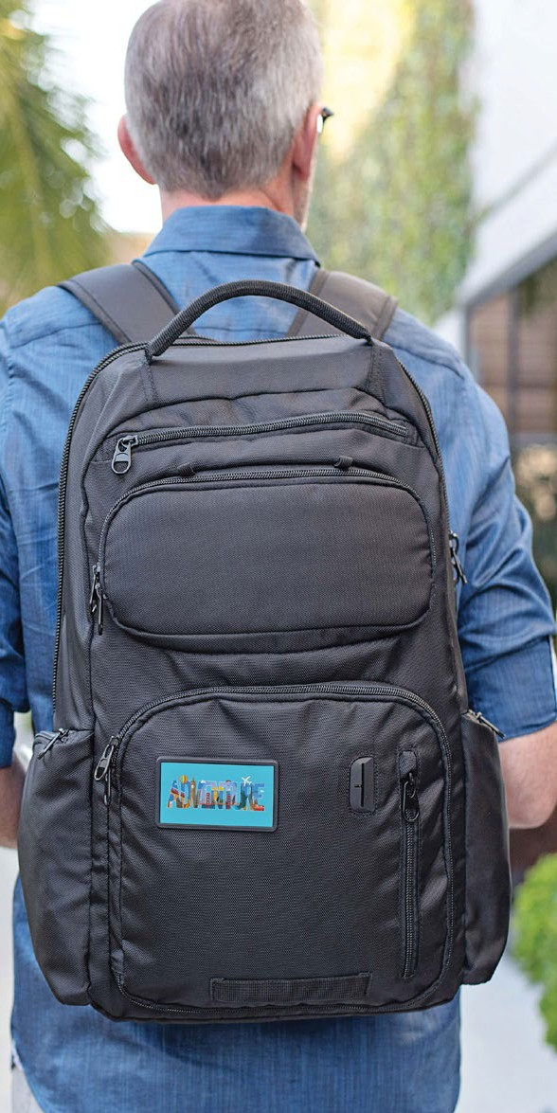
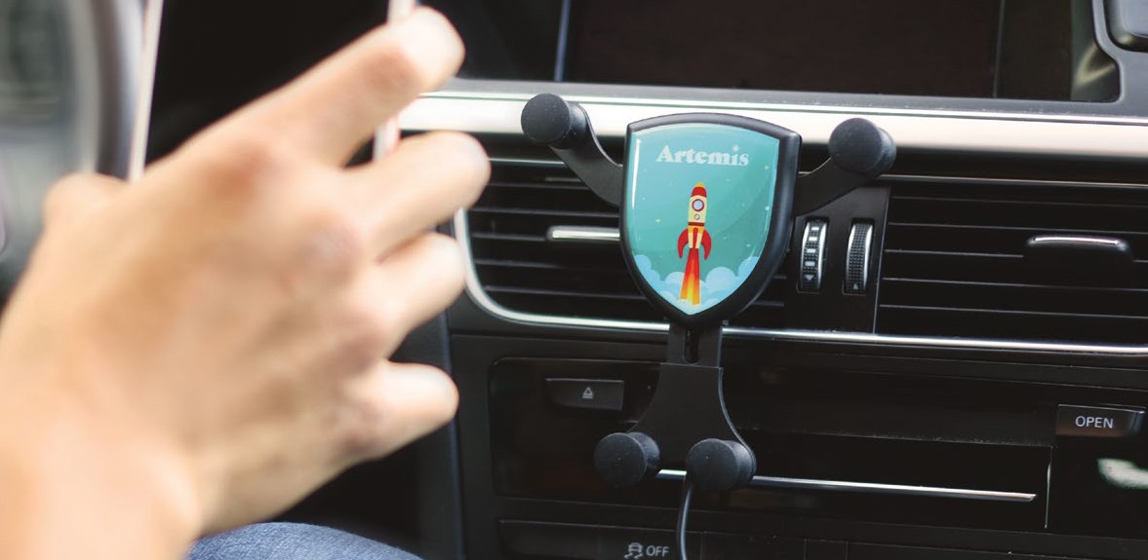
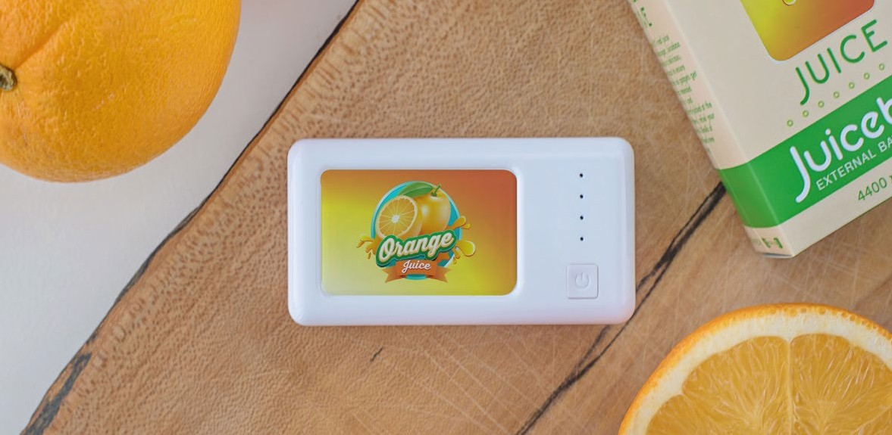
Mission Pack™
Gravitis™
W ir eless C ar C har ger
+
Embarcadero™
B ackpack
+
OR2907
OR1213
OR1205
B ackpack
+
QTY | 1 | 10 | 25 | 50 | 100
5C | 40.37 | 37.90 | 34.25 | 33.02 | 29.97
Juicebox™
Power B ank
+
OR2910
QTY | 1 | 10 | 25 | 50 | 100 |  | QTY 1 | 10 | 25 | 50 | 100 |  | QTY | 1 10 | 25 | 50 | 100
5C | 51.86 | 44.36 | 40.27 | 37.55 | 34.13 |  | 5C 125.13 | 115.11 | 107.61 | 102.61 | 95.10 |  | 5C | 132.64 122.63 | 115.11 | 110.11 | 100.10
18
19

Slide 11
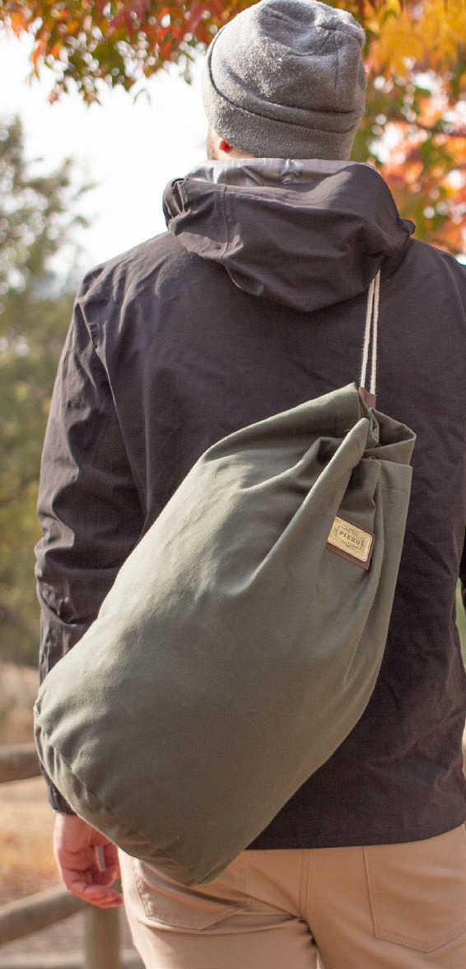
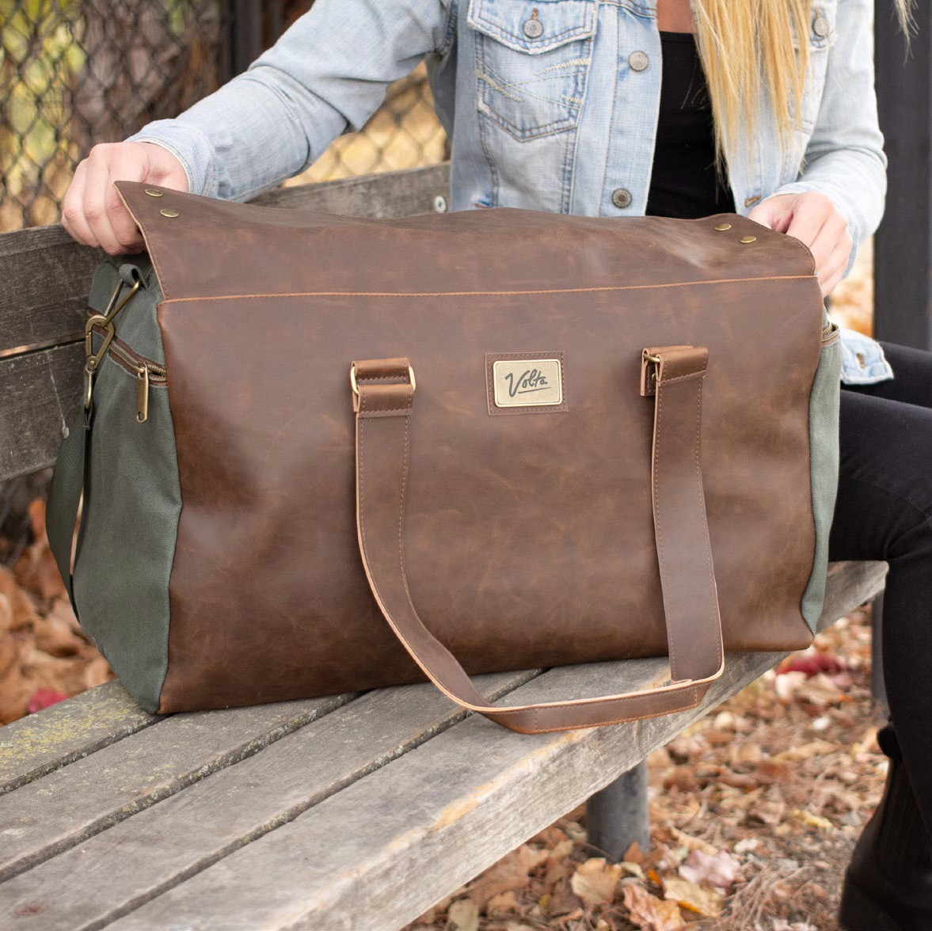
Finley Mill Pack™
Dixon Ditty™
F inley M ill C ollection
+
Danville Duffel™
F inley M ill C ollection
+
OR1250
OR1241
OR1240
F inley M ill C ollection
+
QTY | 1 | 10 | 25 | 50 | 100 |  | QTY 1 | 10 | 25 | 50 | 100 |  | QTY | 1 10 | 25 | 50 | 100
5C | 112.61 | 105.10 | 97.60 | 96.35 | 91.35 |  | 5C 39.25 | 35.98 | 33.35 | 32.05 | 30.75 |  | 5C | 159.58 151.74 | 143.89 | 138.66 | 133.43
20
21

Slide 12
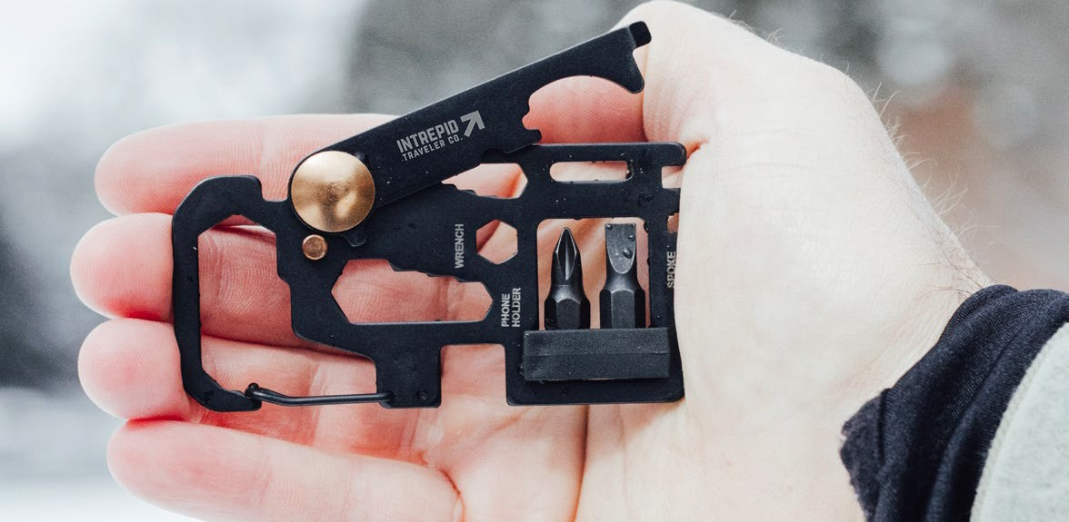
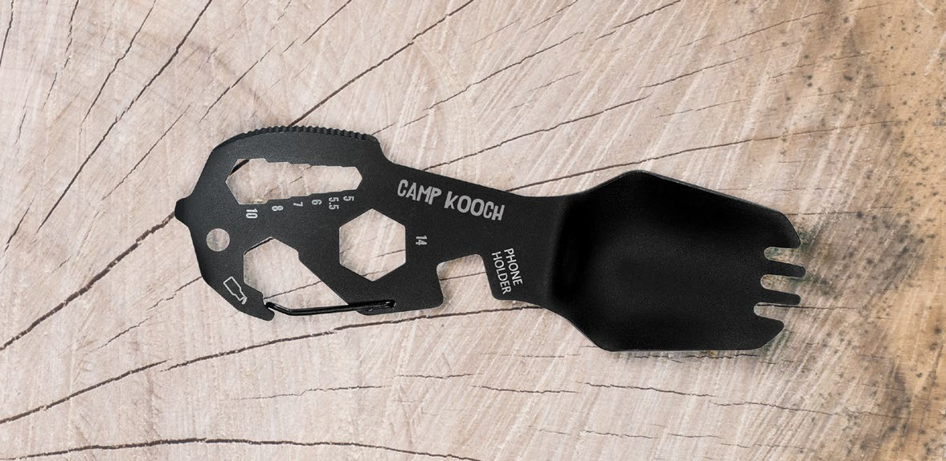
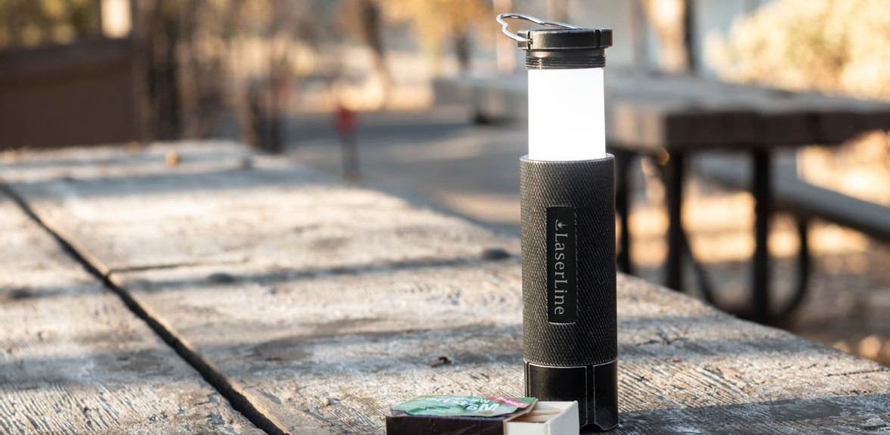
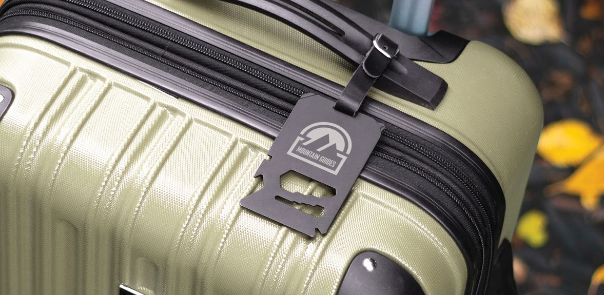
Barrow Spork™
OR1420
Barrow Tool™
Pock et M ulti- Tool
+
OR1422
M ulti- Tool U tensil
+
QTY | 1 | 10 | 25 | 50 | 100 |  | QTY 1 | 10 | 25 | 50 | 100
5C | 28.13 | 24.45 | 22.02 | 20.80 | 18.35 |  | 5C 25.03 | 21.90 | 19.42 | 18.77 | 16.88
Barrow Torch Lantern™
M ulti- P urpose F lashlight
+
OR1423
Barrow Tag™
M ulti- Tool L uggage Tag
+
OR1421
QTY | 1 | 10 | 25 | 50 | 100 |  | QTY 1 | 10 | 25 | 50 | 100
5C | 39.42 | 35.67 | 31.28 | 30.03 | 27.55 |  | 5C 24.40 | 21.28 | 18.77 | 18.15 | 16.88
22
23

Slide 13
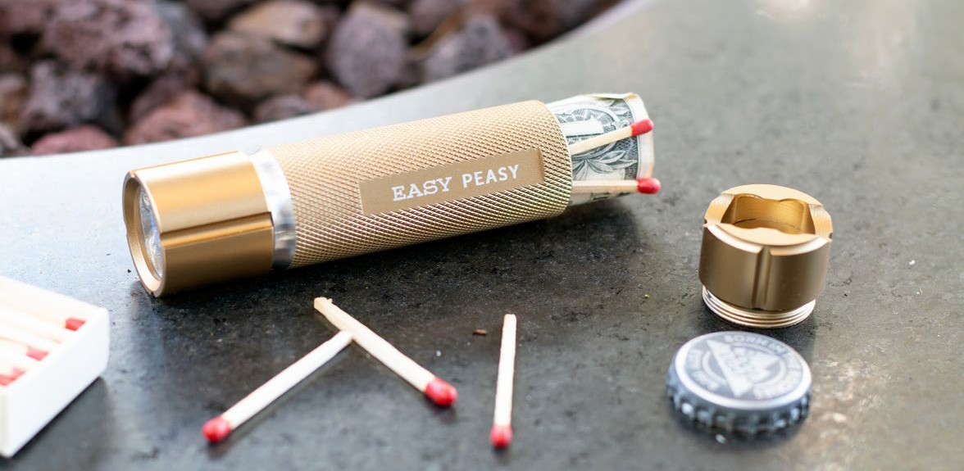
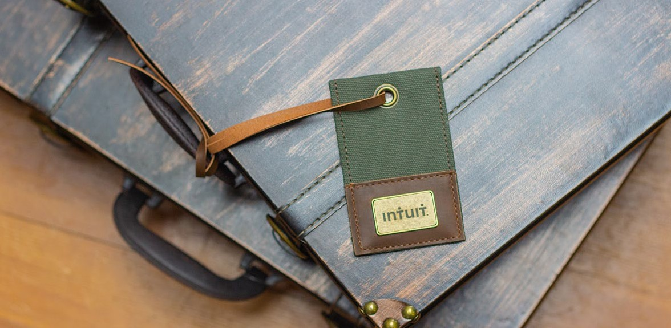
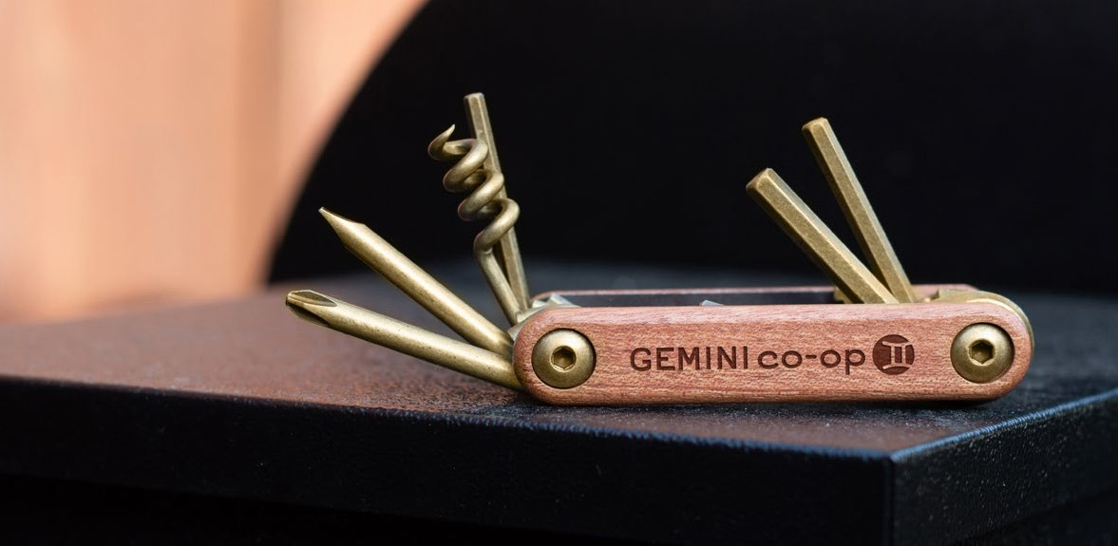
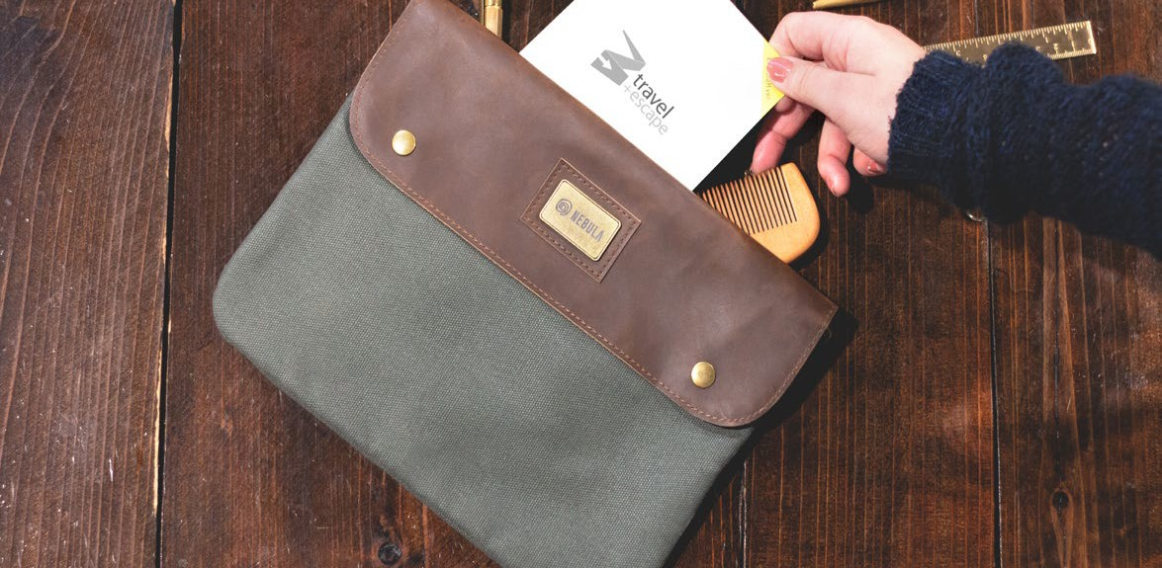
Myers Tag™
Finley Mill Stashlight™
M ulti- P urpose F lashlight
+
OR1452
OR1413
L uggage Tag
+
QTY | 1 | 10 | 25 | 50 | 100 |  | QTY 1 | 10 | 25 | 50 | 100
5C | 24.18 | 21.33 | 19.90 | 19.18 | 17.07 |  | 5C 20.65 | 18.15 | 16.28 | 15.63 | 13.77
Multi-Tool™
F inley M ill C ollection
+
OR1451
Pismo Pouch™
C arr ying C ase
+
OR1416
QTY | 1 | 10 | 25 | 50 | 100 |  | QTY 1 | 10 | 25 | 50 | 100
5C | 30.65 | 28.15 | 26.28 | 25.65 | 23.15 |  | 5C 36.92 | 33.78 | 31.28 | 30.65 | 28.15
24
25

Slide 14
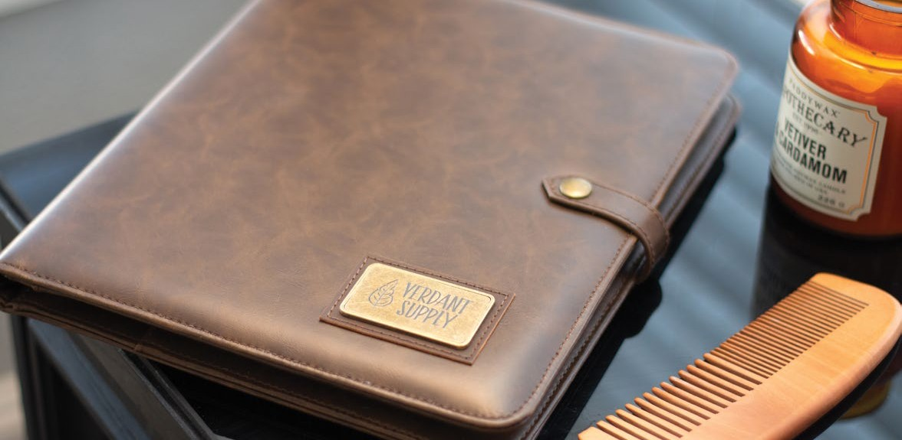
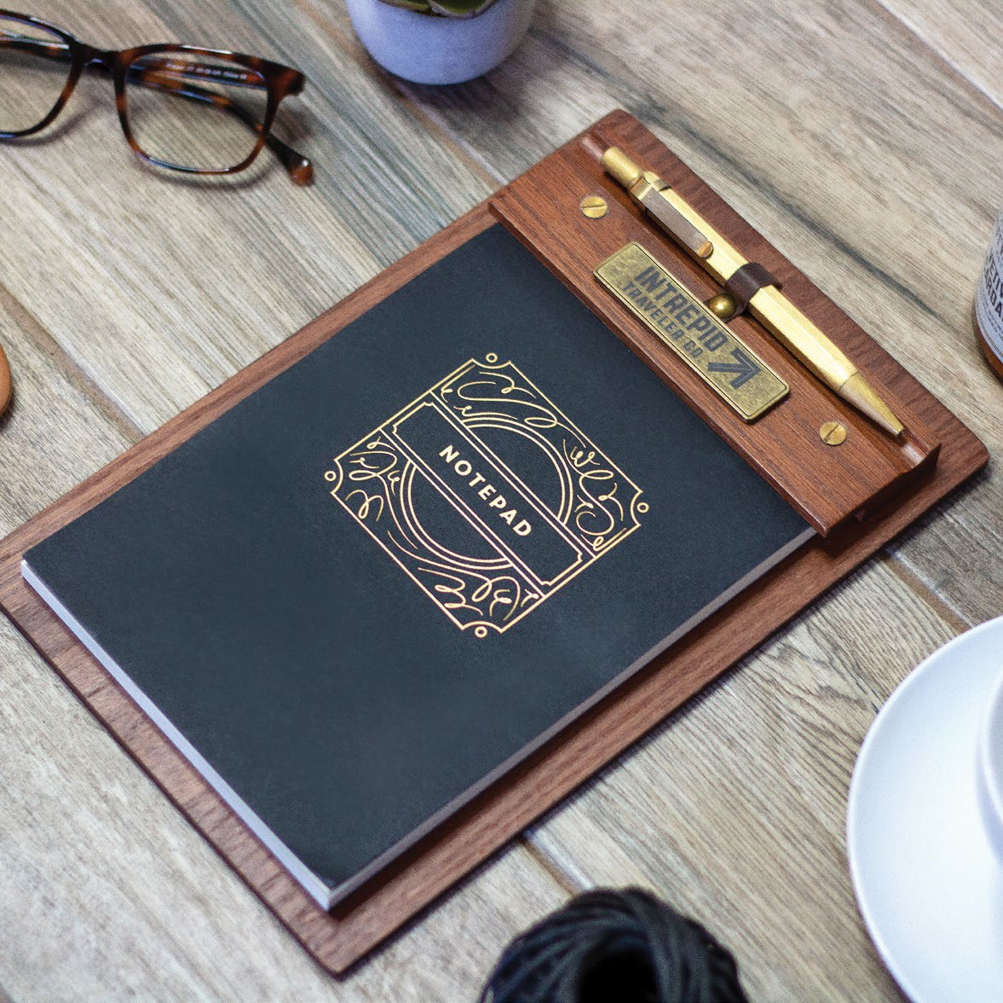
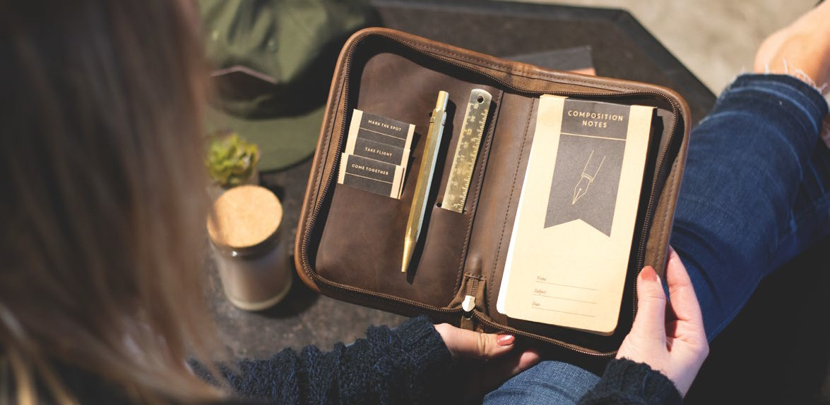
Brockman Set™
Fletcher Folio™
Padfolio
+
OR1453
OR1424
Red O ak wood C lipboard
+
QTY | 1 | 10 | 25 | 50 | 100
5C | 62.98 | 58.70 | 53.80 | 52.58 | 51.36
Somerset™
S tationer y K it
+
OR1419
QTY | 1 | 10 | 25 | 50 | 100 |  | QTY 1 | 10 | 25 | 50 | 100
5C | 58.53 | 54.95 | 50.16 | 48.96 | 45.38 |  | 5C 57.46 | 53.18 | 48.93 | 47.70 | 44.01
26
27

Slide 15
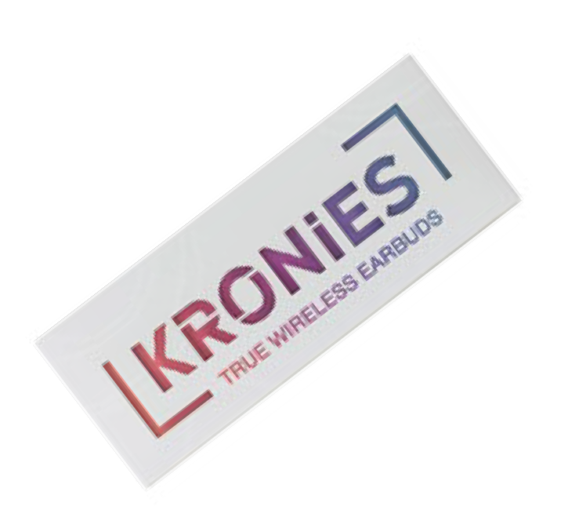
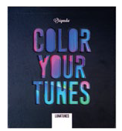
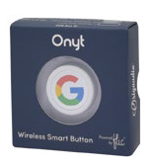
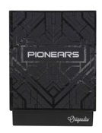
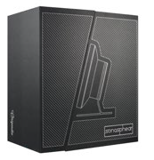
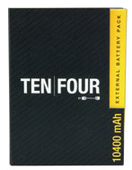
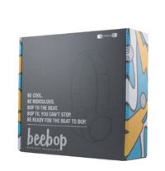
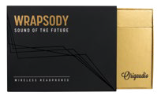
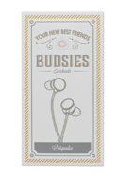
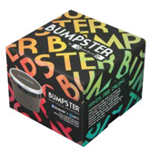
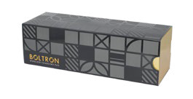
Mindblowing Packaging
The experience includes their spectacular packaging. Check out the designs below that make them so highly coveted at the retail level, perfect for holiday gift-giving.
Kronies™
Lunatune™
Octoforce 2.0™
Onyt™
Pionears™
Sonosphear™
Tenfour 2.0™
Thumpah™
Wrapsody™
Beebop™
Boltron™
Boxanne™
Budsies™
Bumpster™
Evrybox™
Flyington™
Gravitis™
Hive™
JuiceBox™
Barrow Torch™
Barrow Tool™
Barrow Tag™
Barrow Spork™
28
29

Slide 16
Mindblowing Options
CUSTOM PACKAGING
Take your promo to the next level by customizing your product packaging with your own branding and messaging.
Visit the link below or ask your representative
for full details.
30
31

Slide 17
Egg Drop™
HS2305
Coconut™
W ir eless S peak er
+
HS2303
Levitating W ir eless S peak er
+
QTY | 1 | 10 | 25 | 50 | 100
5C | 136.04 | 125.40 | 107.85 | 95.01 | 91.36
MyBuds™
W ir eless E arbuds
+
HS2513
QTY | 1 | 10 | 25 | 50 | 100 |  | QTY 1 | 10 | 25 | 50 | 100
5C | 256.14 | 239.78 | 206.86 | 182.29 | 175.29 |  | 5C 156.98 | 145.34 | 125.10 | 110.23 | 106.00
32
33

Slide 18
Navigator Sling 6L
NVSL06
Navigator Backpack 15L
B ackpack W ith 2 E xternal C arr y S traps
+
NVBP15
S ling B ag W ith S tabilizer S trap
+
S tarting at $166. 00 (E)
S tarting at $319. 00 (E)
34
35

Slide 19
Navigator Travel Pack 32L
NVTP32
The Carry On Classic
Travel S uitcase
+
RLCN00
Travel B ackpack W ith Waist S traps
+
S tarting at $5 11. 00 (E)
S tarting at $5 11. 00 (E)
36
37

