Slide 1
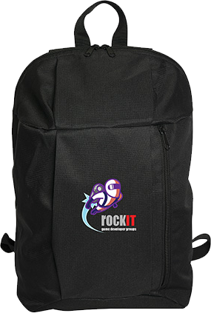
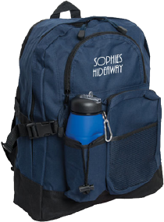
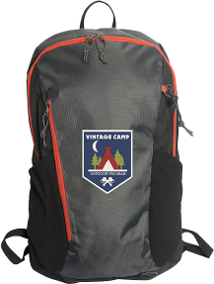
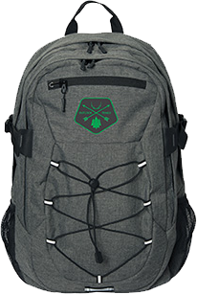
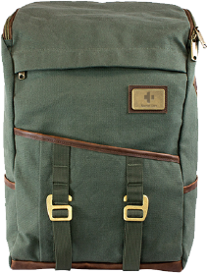
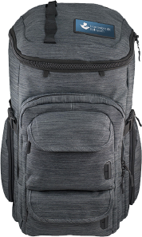
Take A Hike
This year more than ever they can't wait to get outside! Walking, hiking, exploring, picnics, bike rides, canoe trips, road trips you name it we can pair it with the perfect pack. We've got a hearty selection of backpacks giving you the right gear for any adventure.
KN9647
Burble Laptop Backpack
P1921
Backpack
KN9400
Traxx Backpack
Starting at
$22.32
Starting at
$30.26
Starting at
$42.86
KN9452
Savannah Trail Backpack
OR1250
Finley Mill Pack™
OR1213
Mission Pack™
Starting at
$79.78
Starting at
$102.38
Starting at
$108.33

