Slide 1
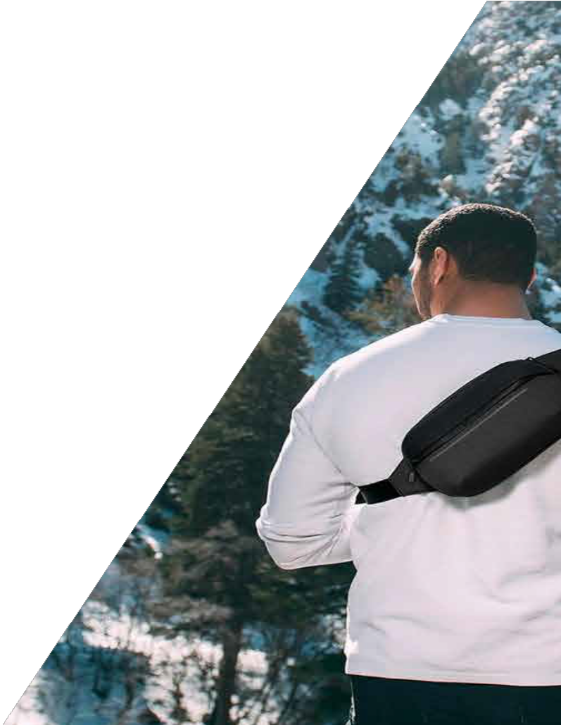
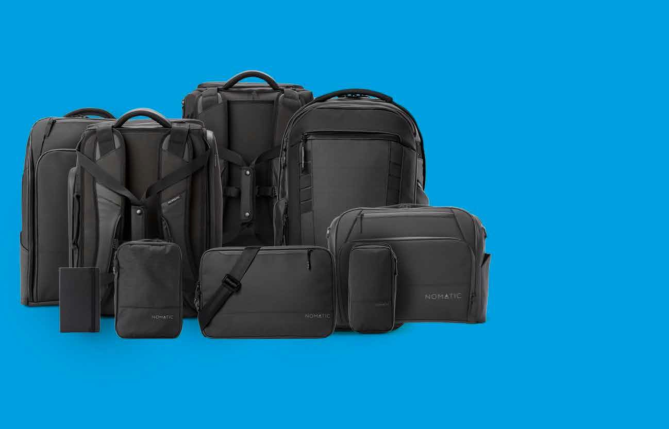
Life On The Move
Built for function, driven by innovation, Nomatic gear is designed to adapt to every situation - from the boardroom to the beach.
Backed by quality materials and top-of-the-line manufacturing, Nomatic creates products that inspire confidence for life on the move.
1 piece minimum Ships in 48-hours
Customized gift message in every order

Slide 2
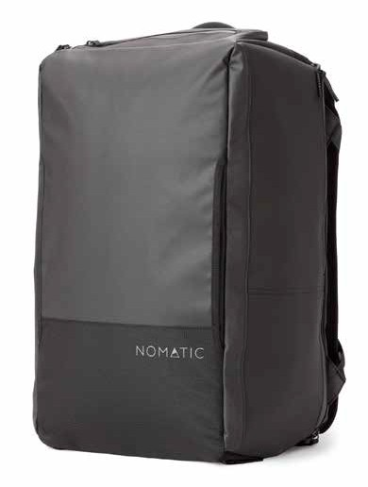
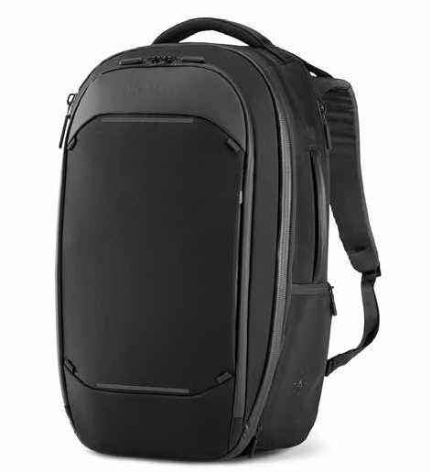
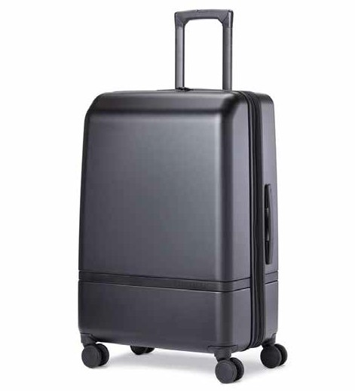
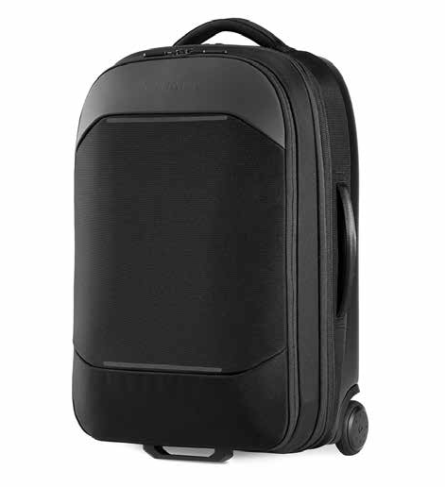
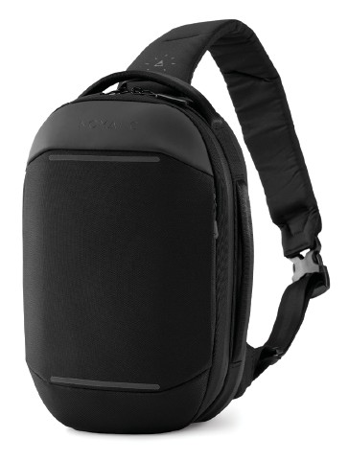
Our Featured Bags!
40L TRAVEL BAG
15L NAVIGATOR BACK PACK
NAVIGATOR SLING 6L

