Slide 1
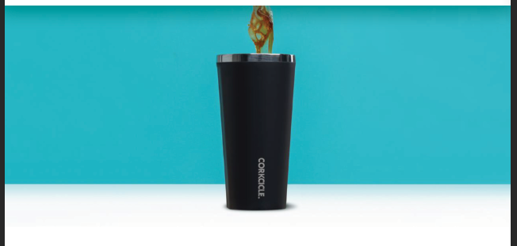
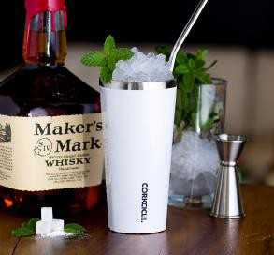
INTRODUCING
Let the good times flow.
CK2025
CLASSIC 25oz. CANTEEN
Min qty. 10 Starting at $82.92
CK2016
CLASSIC 16oz. CANTEEN
Min qty. 10 Starting at $72.46
CK2124
CLASSIC 24oz. TUMBLER
CK2016
CLASSIC 16oz. TUMBLER
Min qty. 10
Starting at $72.46

Slide 2
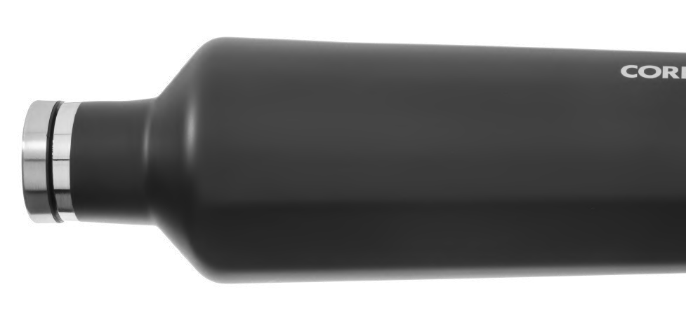
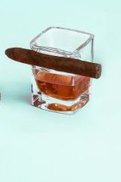
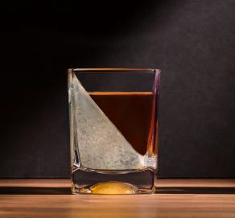
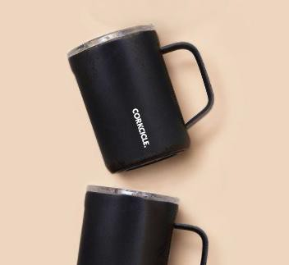
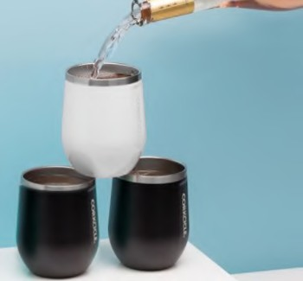
INTRODUCING
Let the good times flow.
CK7107
CIGAR GLASS
Min qty. 10 Starting at $60.30
CK7001
WHISKEY WEDGE
Min qty. 10 Starting at $48.20
CK2516
16oz. COFFEE MUG
CK2312
CLASSIC 12oz. STEMLESS
Min qty. 10
Starting at $70.86

